Slide 1
To Know from Keeley (2004)
What Final conversations (FCs) are
Freq of love-messages in FCs
Types (& ex’s) of love comm. in FCs
Affirmation
Love & Reconciliation
Altruistic

Slide 2
Importance of Intimacy
SD & intimacy
Associated with

Slide 3
Features of Intimacy
Self-Disclosure/Trust
for Members
Closeness/
Shared

Slide 4
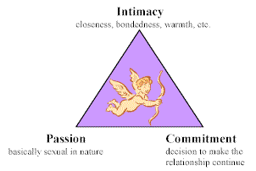
Sternberg’s (1986) Triangle of Love

Slide 5
“Love Languages” (LLs)
Acts of Service
Touch
Words of Affirmation
Gifts
Quality Time
YOUR INFO FROM SCALES!!!

Slide 6
“Axioms” of LLs theorized implicitly, never tested! (Chapman, 2010)
All have & style?
May be diff w/
But should apply cross-contextually? (e.g., workplace)
Change over (e.g., children to adult)
Change (diff from relationally)
Prefer to
No major diffs
Knowing important!
Allows YOU to comm. them to other
Knowing important!
Allows YOU to adjust to other (what makes them feel loved/appreciated)

Slide 7
Do LOVE Survey
Here’s the link for you:
https://www.surveymonkey.com/r/FSVKKCK
Also, it would be an AMAZING HELP if you would all distribute to people in your life (email lists, Facebook posts, etc.) to help us get more participants too!

